Slide 1
Computer Modeling and Simulation
Lectures 27&28

Slide 2
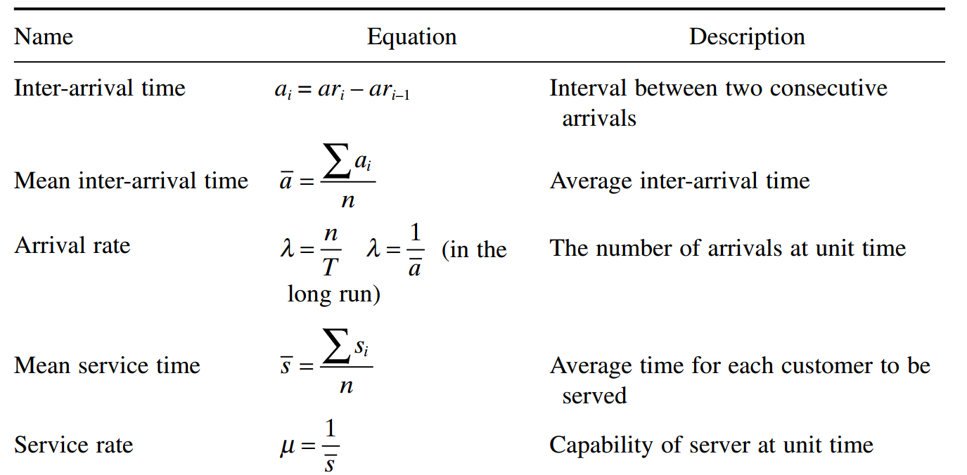
Key Equations in Queuing Model

Slide 3
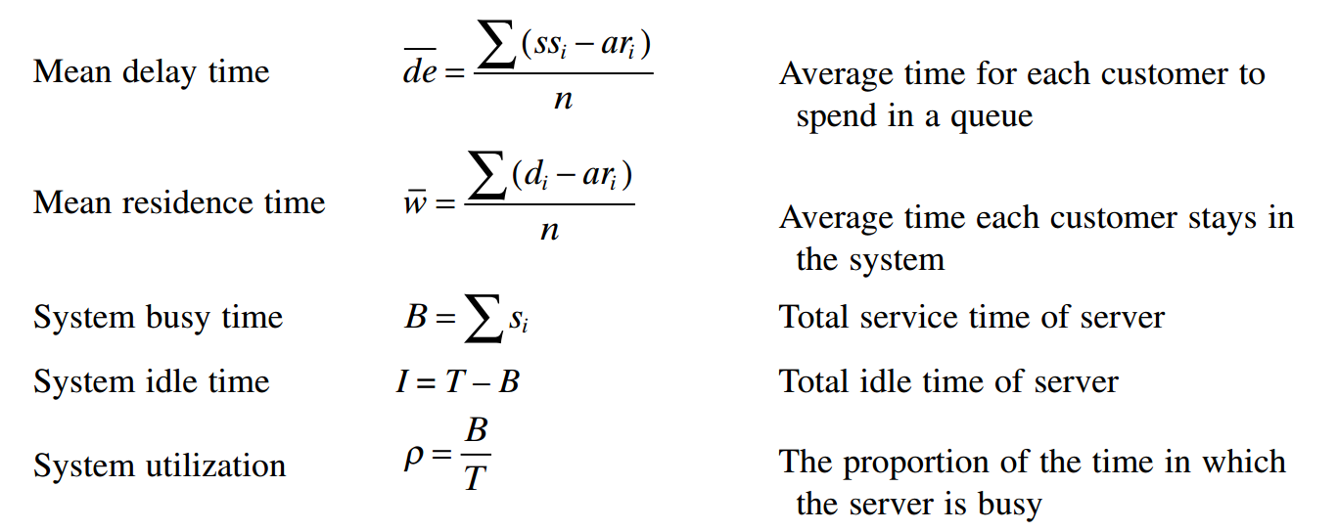
Key Equations in Queuing Model

Slide 4
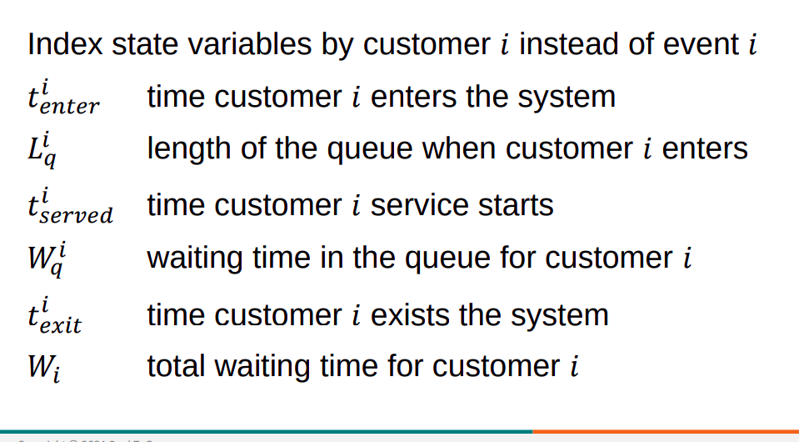
Customer-Centric Simulation

Slide 5
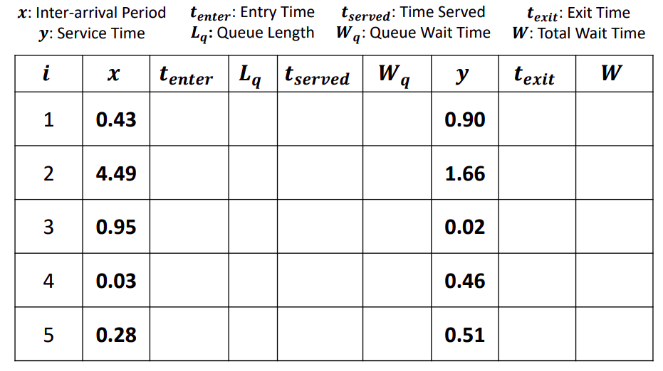
Customer-Centric Simulation

Slide 6
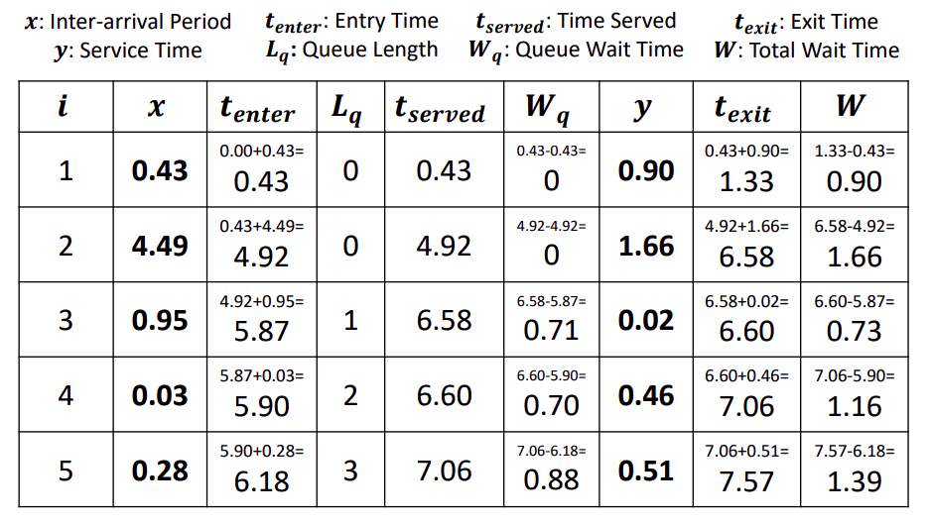
Customer-based Simulation

Slide 7
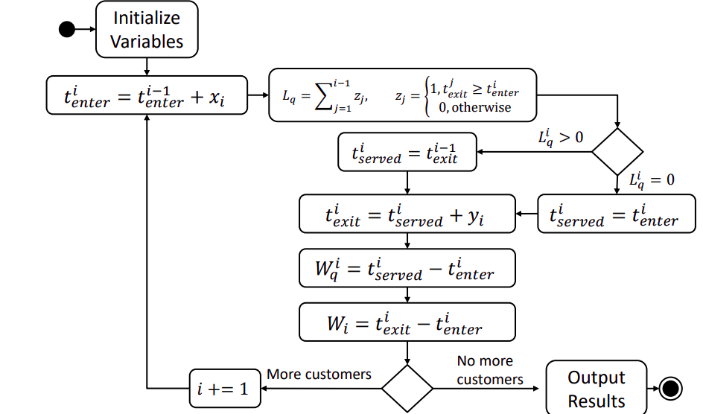
Customer-based Simulation

Slide 8
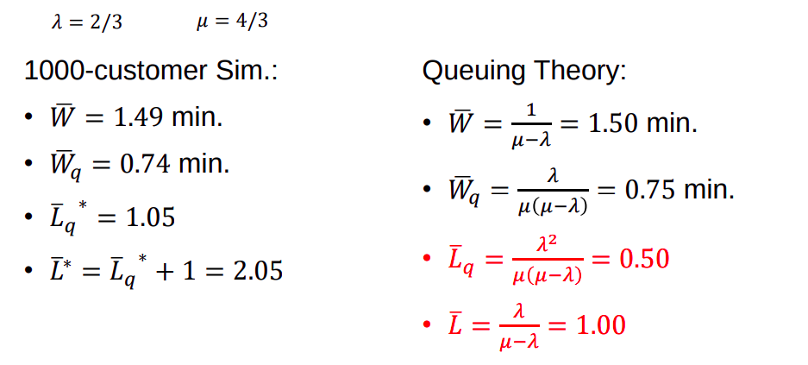
Customer-based Simulation

Slide 9
Another Example of Customer based Simulation
Consider the following example of a grocery store with only one checkout counter.
The customer waits for the cashier in a line.
The inter - arrival time, arrival time, service time and departure time for each customer are given in the following table.

Slide 10
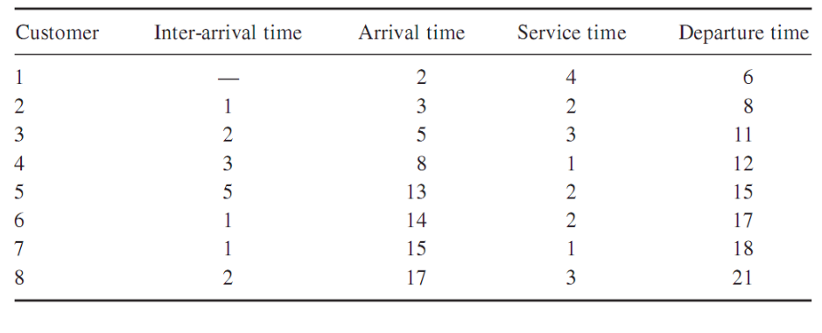
Another Example of Customer based Simulation

Slide 11
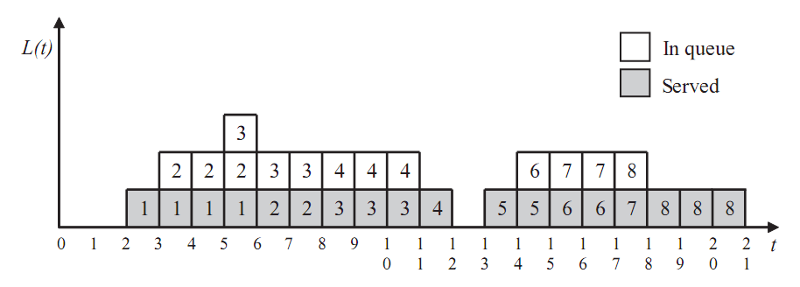
Simulation of Queuing Model

Slide 12
Little’s Law
The average number of customers ( L ) is equal to the arrival rate ( λ ) multiplied by the average time ( w ) the customer spends in the system:
L = λ w .
Little ’ s law is meaningful in that the law holds regardless of any kind of the arrival and service distribution.
Thus, Little ’ s law does not require restricted assumptions for the types of arrival and service patterns.

Slide 13
Little’s Law
The average customer ( L ) at time t can be calculated from the figure as follows.
L = (1 + 2 + 2 + 3 + 2 + 2 + 2 + 2 + 2 + 1 + 1 + 2 + 2 + 2 + 2 + 1 + 1 + 1)/21 = 1.48.
The arrival rate ( λ ) is 8/21 = 0.38.
The mean residence time ( w ) is (4 + 5 + 6 + 4 + 2 + 3 + 3 + 4)/8 = 3.88.
The average number of customers in the system can be calculated from Little ’ s law: L = λ w = 0.38 × 3.88 = 1.48.
The result of Little ’ s law is the same as that of simulation.

Slide 14
Limitation of Customer-based Simulation
Need to maintain history of all customers
Huge space complexity

Slide 15
Discrete Event Simulation-Model Constructs
Time variable: Store the current simulation time
Event list/stack: List of future events with associated execution times
System state variables: Store state variables which persist across time
Counter variables: Store derived state variables that record useful observations for analysis

Slide 16
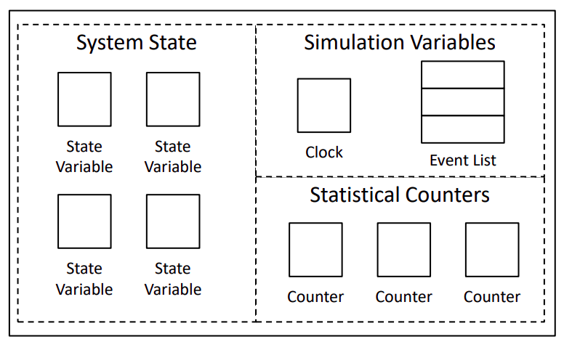
Discrete Event Simulation-Model Constructs

Slide 17
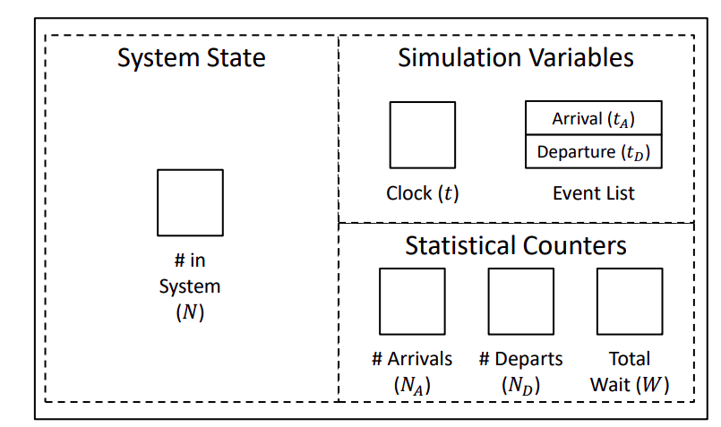
Discrete Event Simulation-Model Constructs

Slide 18
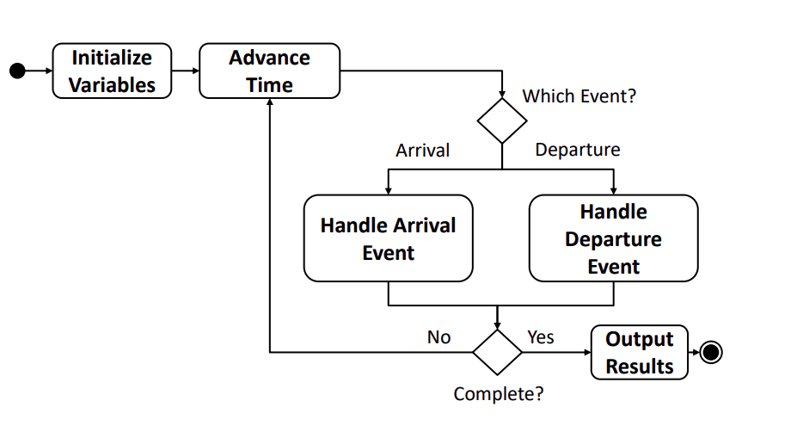
Queuing Activity Diagram

Slide 19
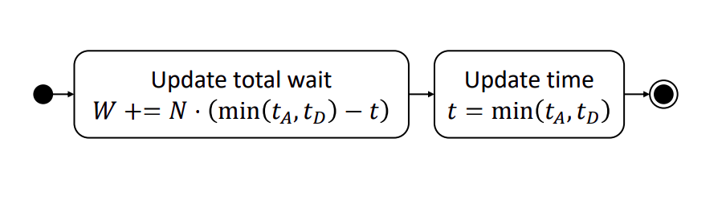
Advance Time

Slide 20
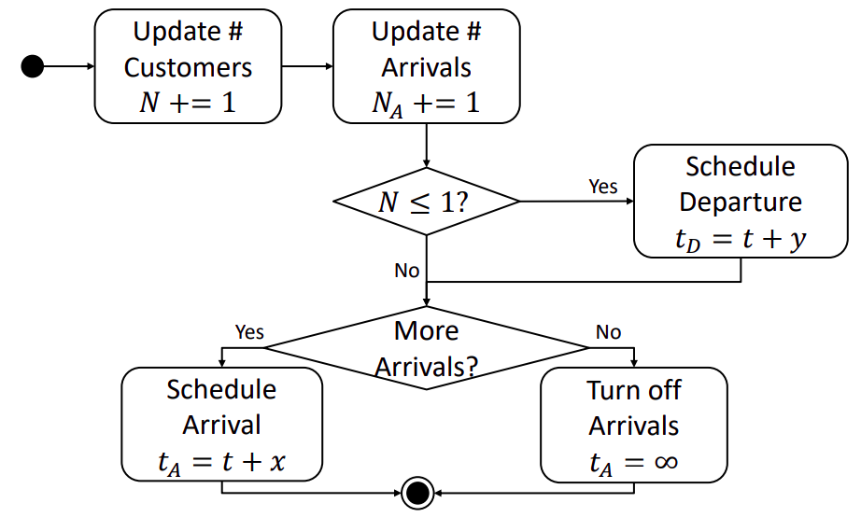
Handle Arrival Event

Slide 21
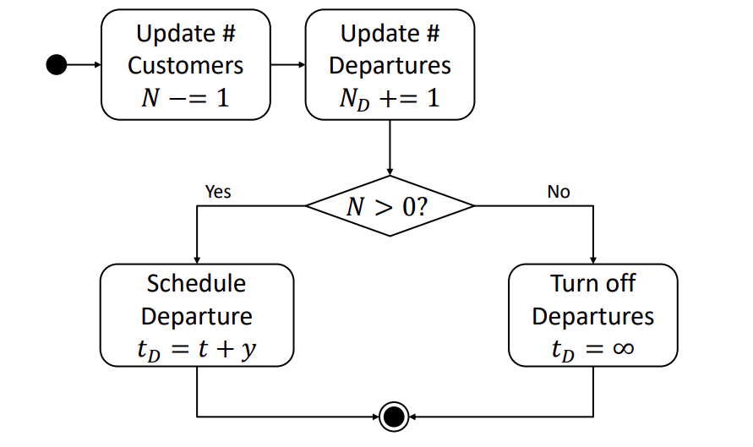
Handle Departure Event

Slide 22
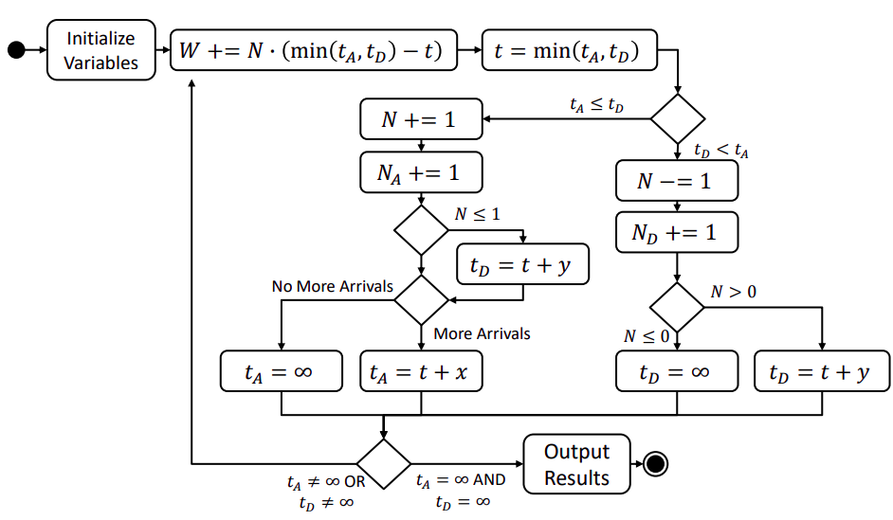
Complete Activity Diagram

Slide 23
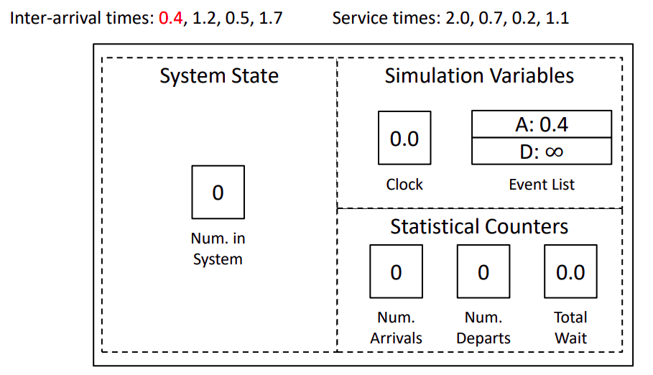
Initialize Simulation

Slide 24
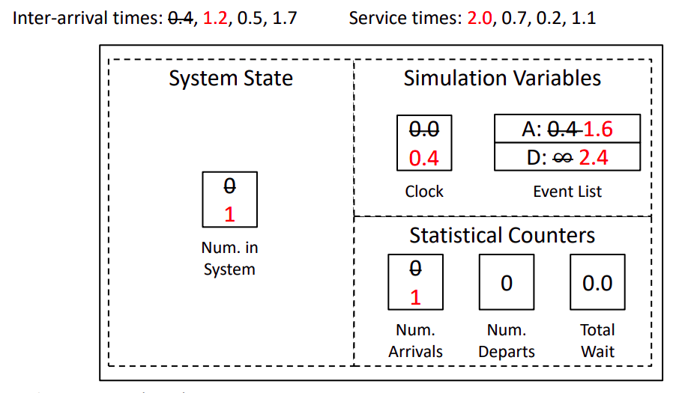
Arrival Event @ 𝒕 = 𝟎.4

Slide 25
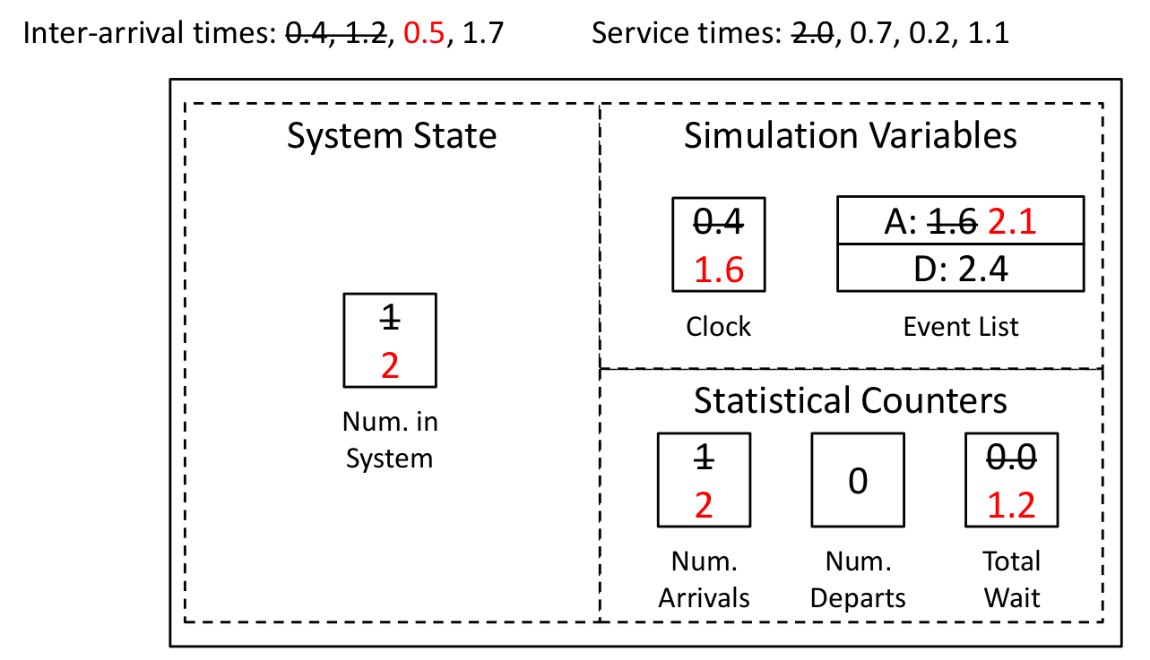
Arrival Event @ 𝒕 = 1.6

Slide 26
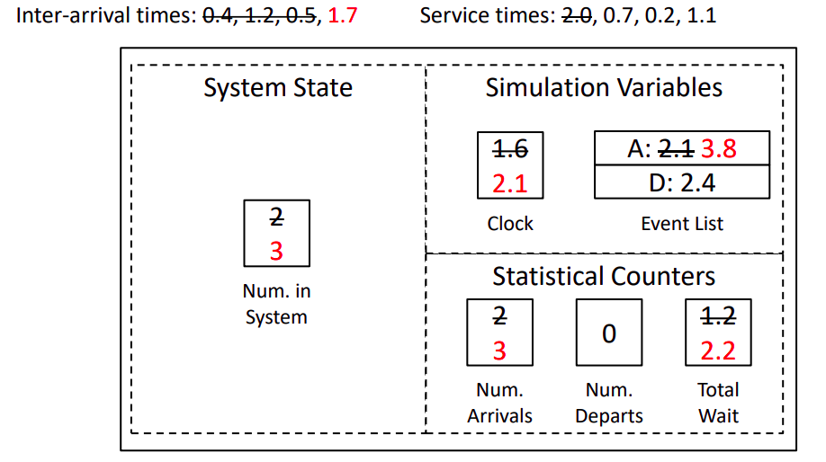
Arrival Event @ 𝒕 = 2.1

Slide 27
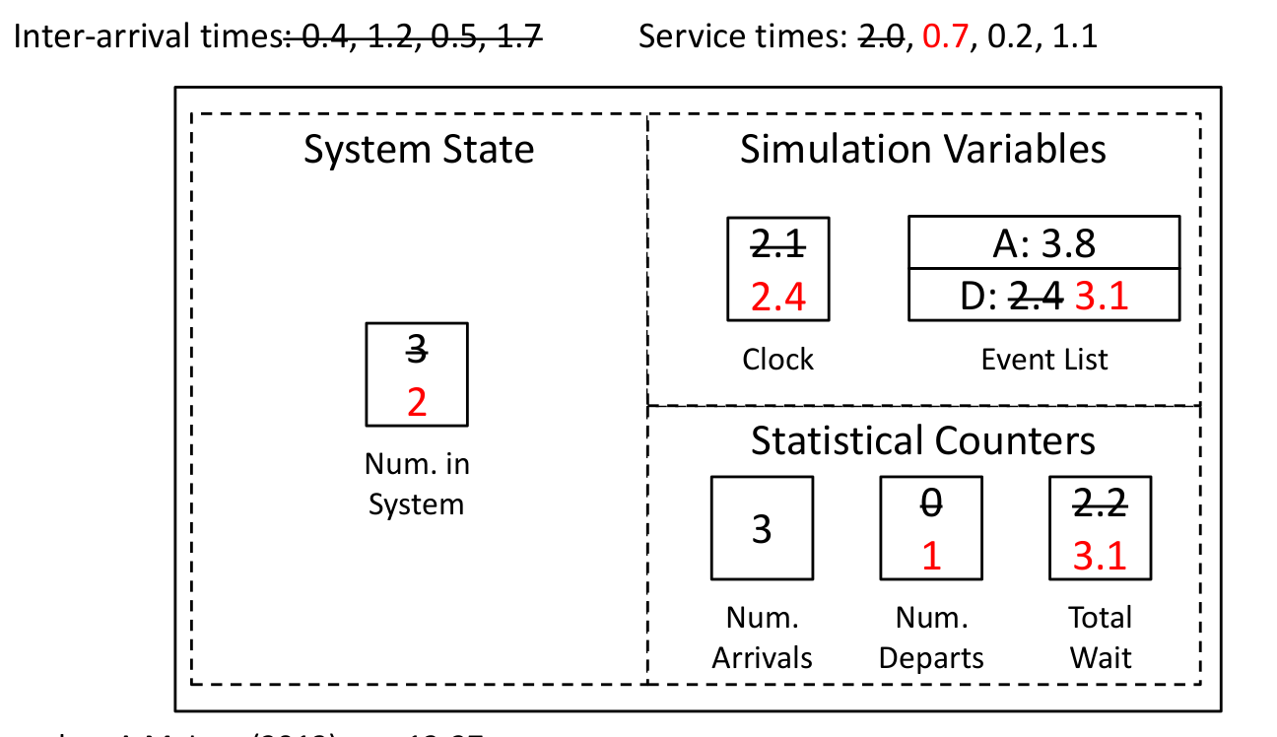
Arrival Event @ 𝒕 = 2.4

Slide 28
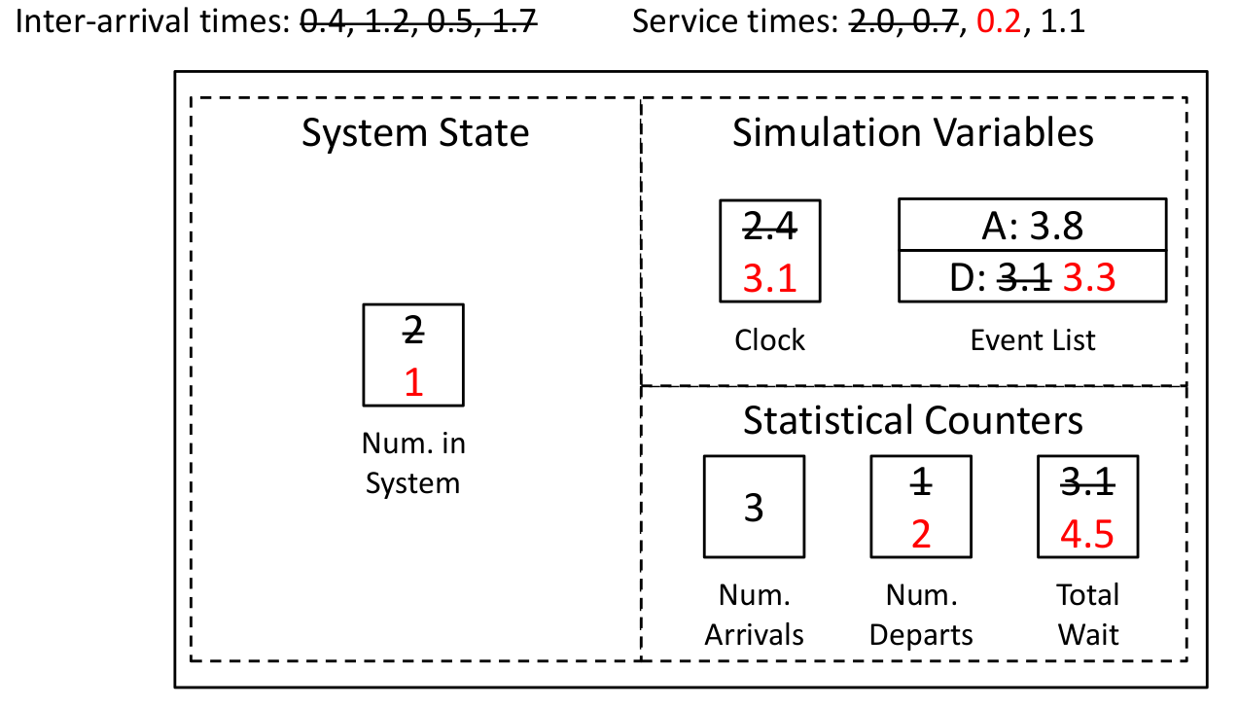
Departure Event @ 𝒕 = 3.1

Slide 29
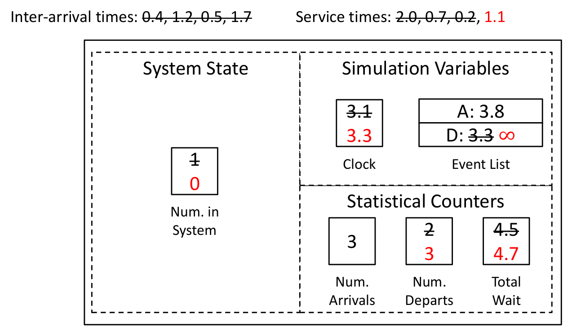
Departure Event @ 𝒕 = 3.3

Slide 30
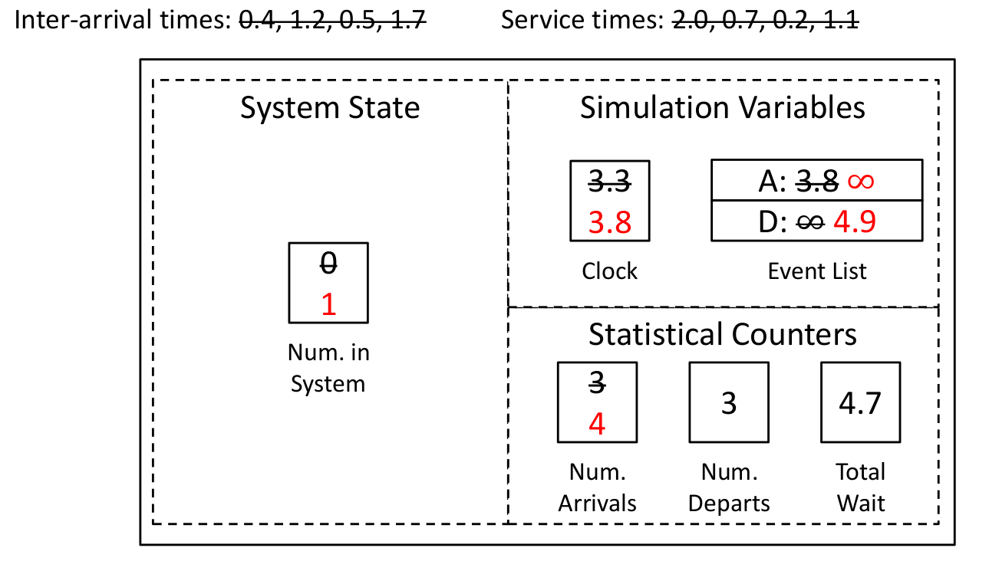
Arrival Event @ 𝒕 = 3.8

Slide 31
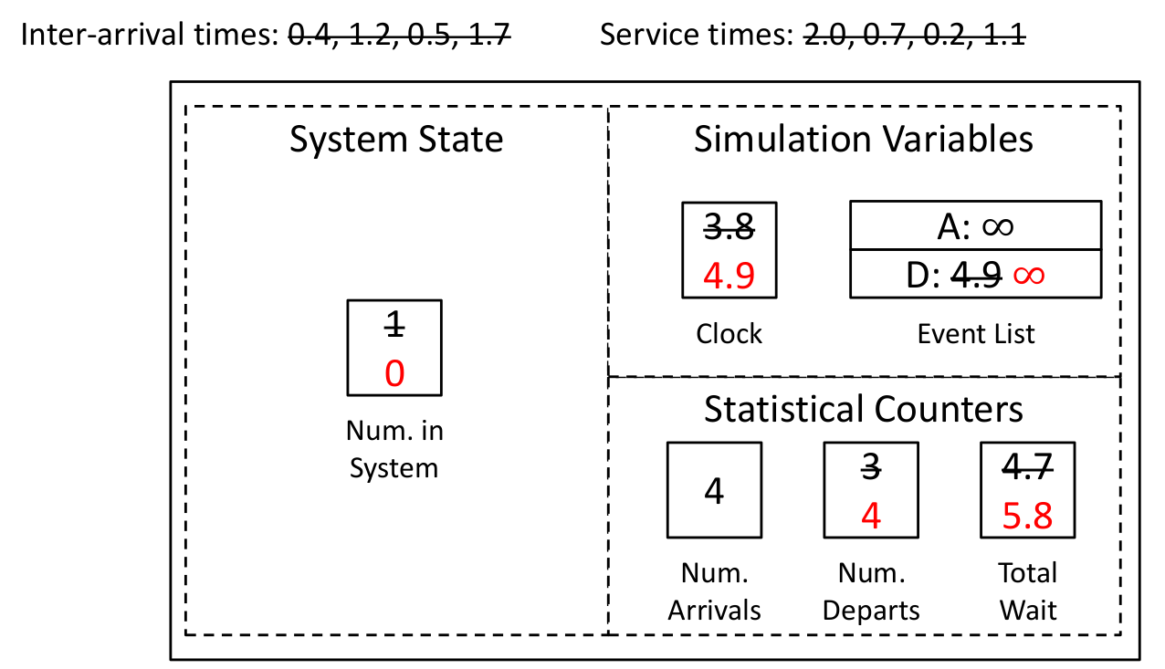
Departure Event @ 𝒕 = 4.9

Slide 32
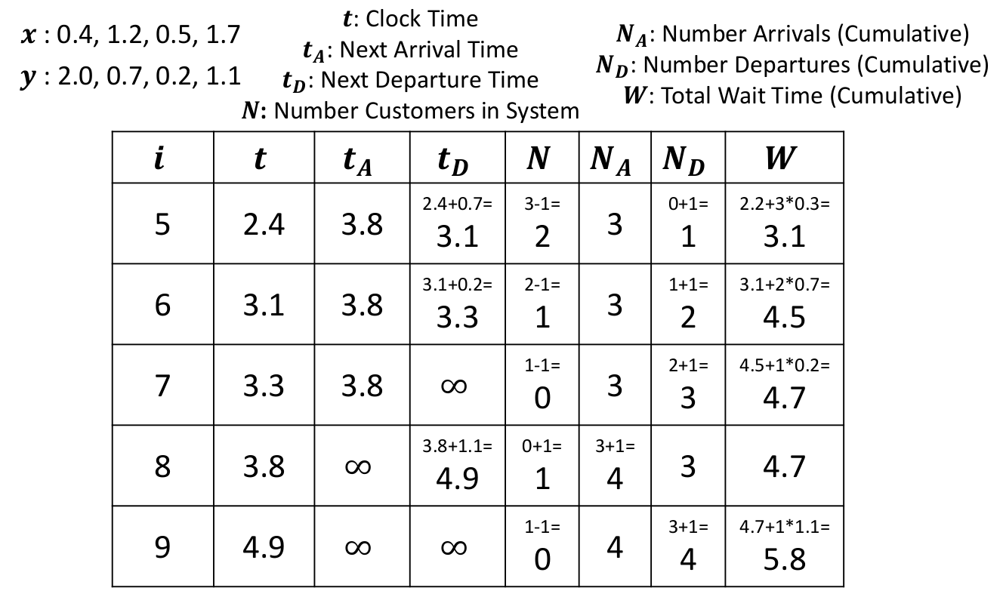
Event-based Simulation

Slide 33
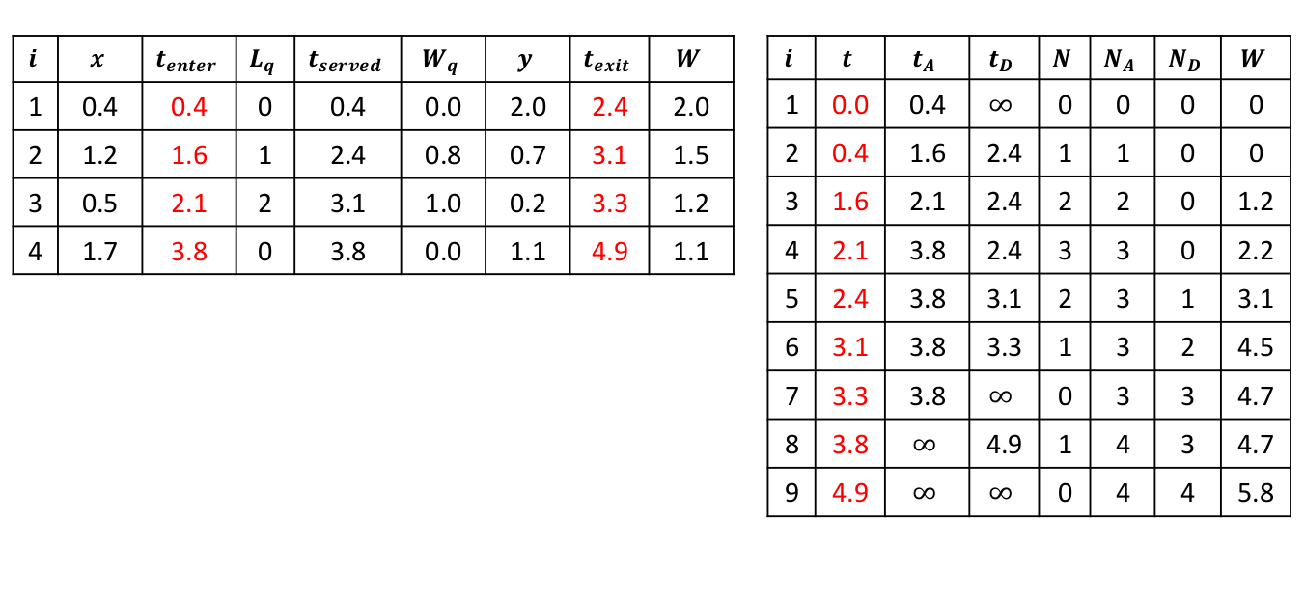
Customer vs Event based Simulation

